Slide 1

Analyzing Suicide Rates from 1985 to 2016
By Monty Python the SQL

Slide 2
introduction
For this presentation we're analyzing data regarding suicide rates from 1985 to 2016. Data was procured from Kaggle compiled from resources including the United Nations Development Program, the World Bank, the World Health Organization and another Kaggle dataset named, "Suicide in the Twenty-First Century".
Visualizations will be presented to further understand the data and share insights. Also we will present a neural net aiming to predict a tier of possible suicide rates for a country given the provided data.

Slide 3
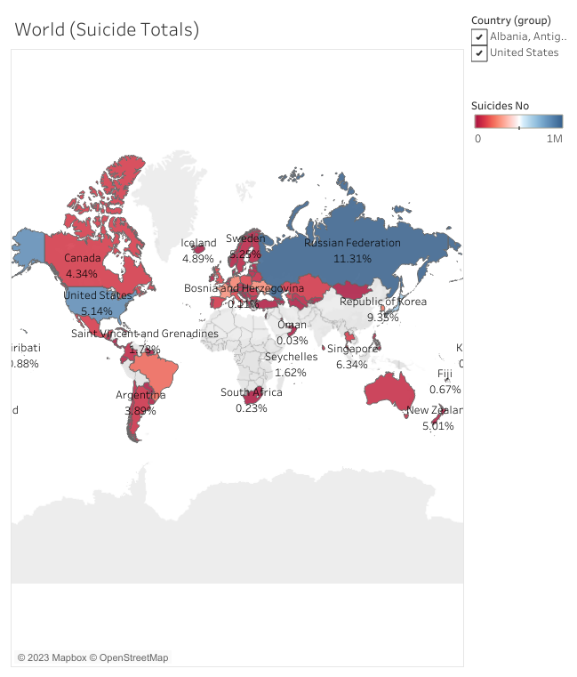
Global statistics
This visualization shows the percentage of a country's population that has committed suicide.
World Suicide Totals

Slide 4
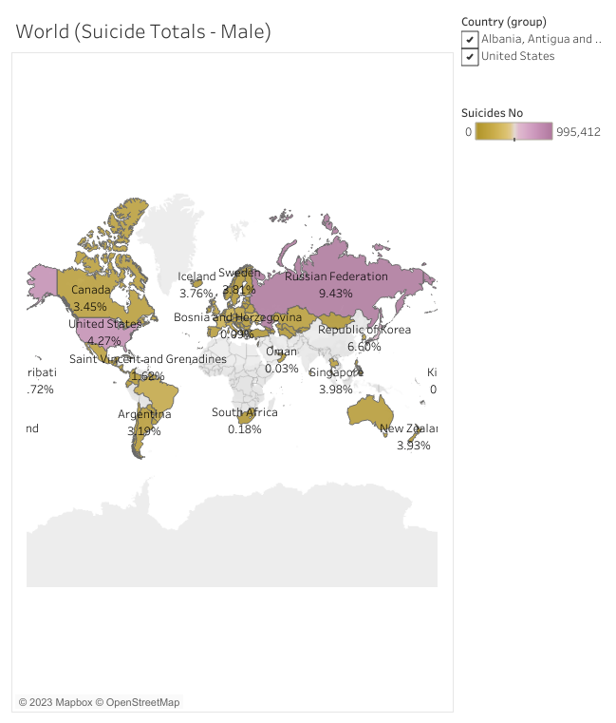
Global statistics
This visualization shows the percentage of a country's male population that has committed suicide.
World Suicide Totals - Male

Slide 5
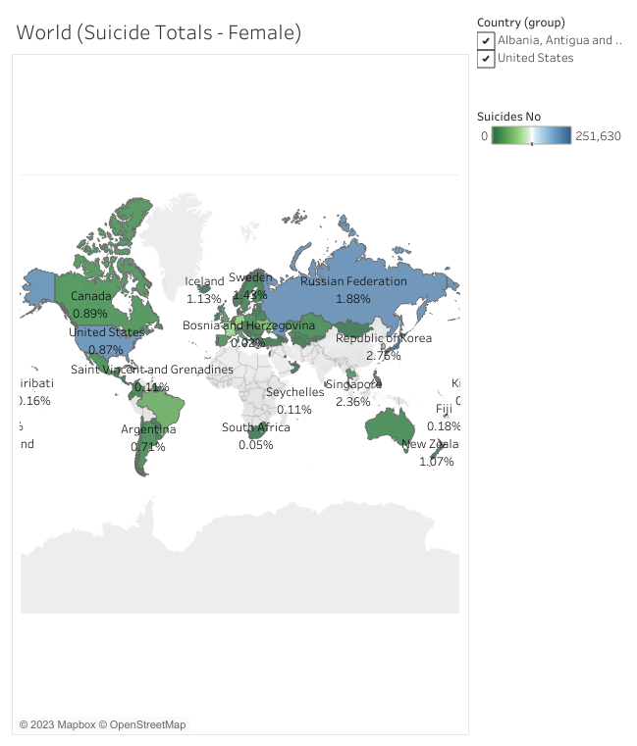
Global statistics
This visualization shows the percentage of a country's female population that has committed suicide.
World Suicide Totals - Female

Slide 6
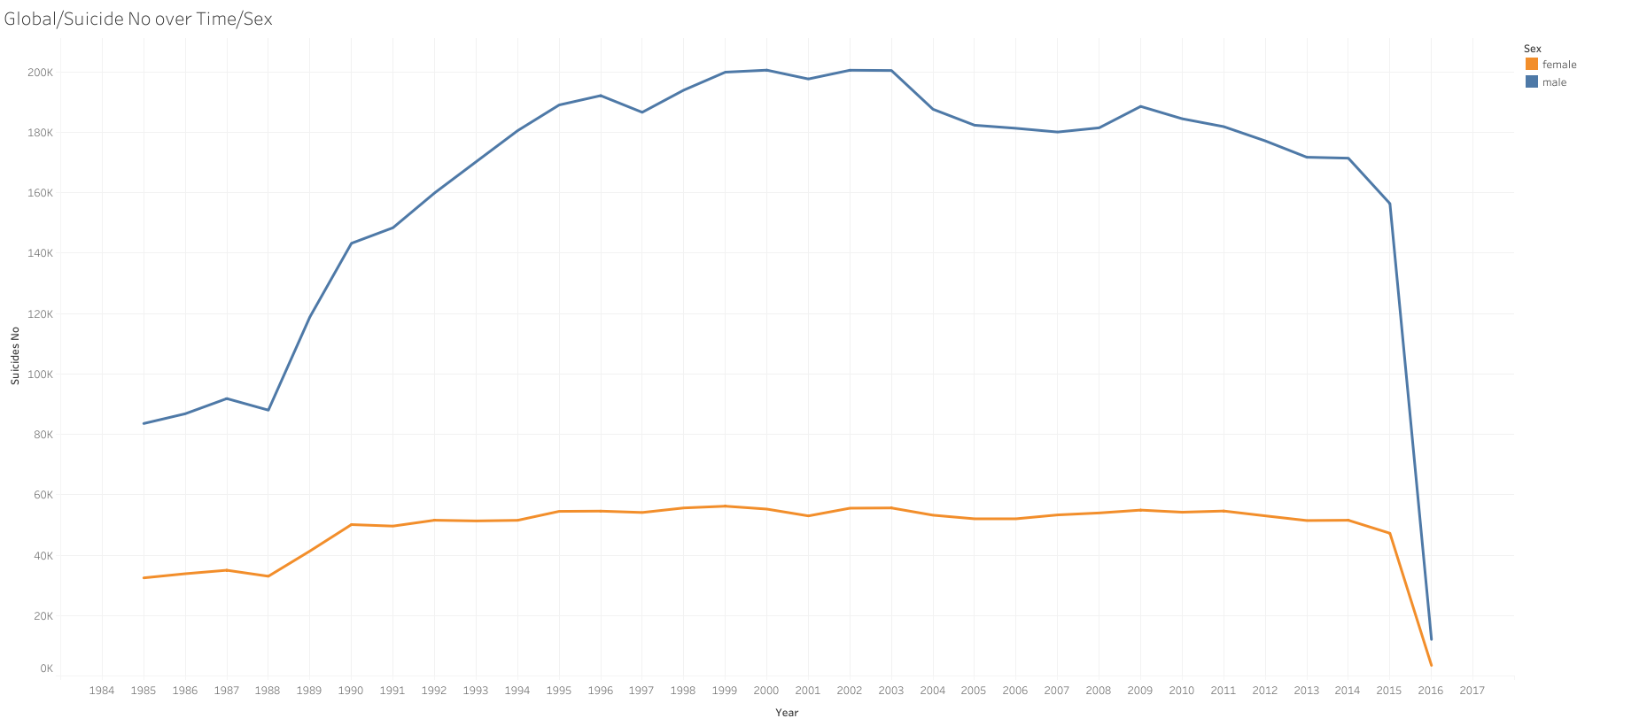
Global statistics
This visualization shows the global suicide numbers over time broken down by sex.
Global Suicide Numbers by Sex

Slide 7
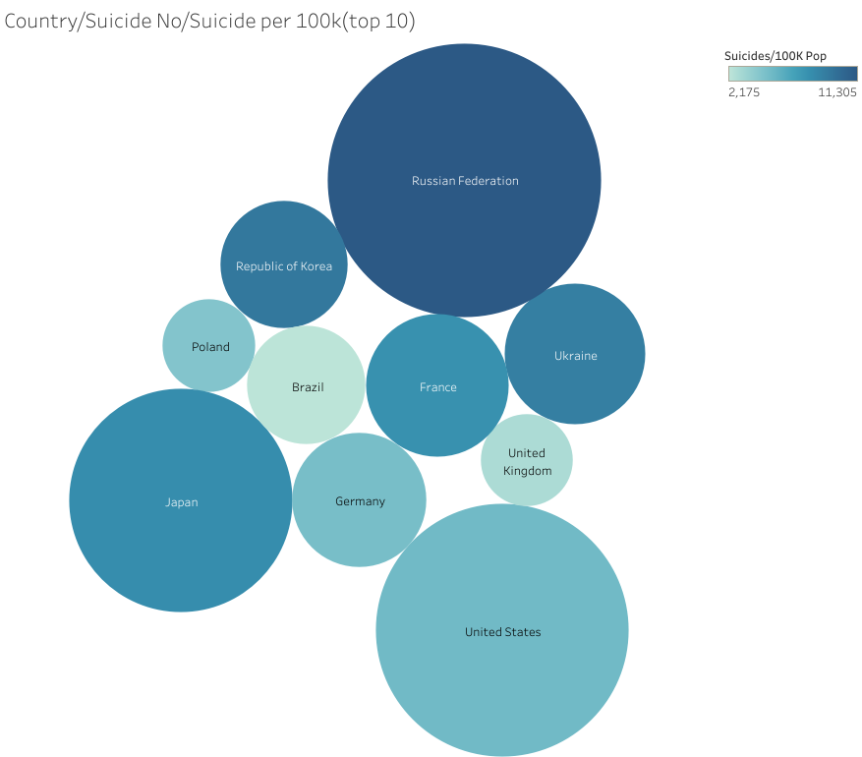
Global statistics
This visualization shows the global suicide numbers and suicide per 100K for the Top 10.
Global Suicide Numbers for Top 10

Slide 8
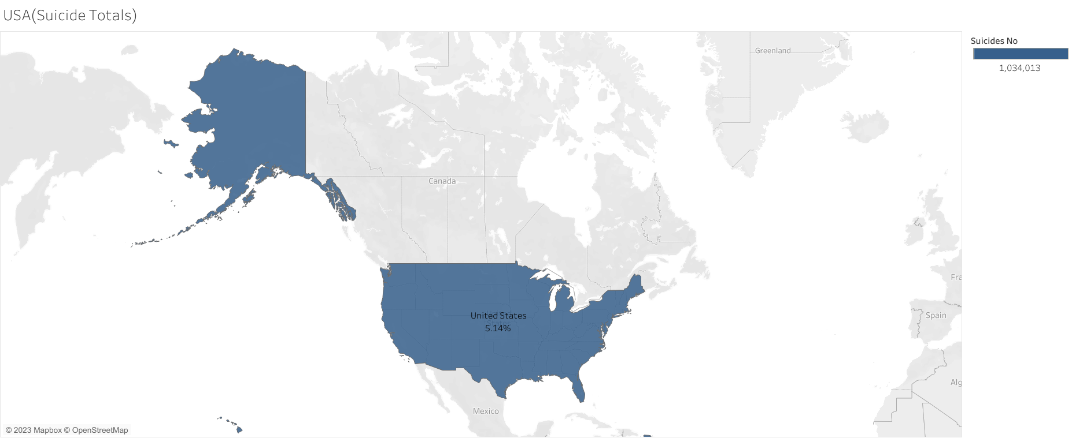
domestic statistics
Domestic Suicide numbers
This visualization shows the domestic suicide rates.

Slide 9
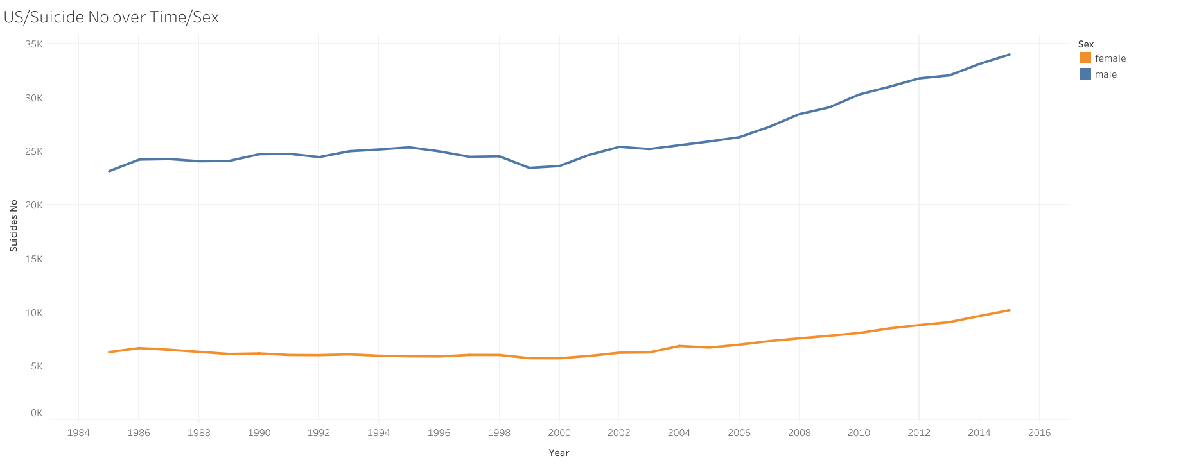
domestic statistics
This visualization shows the domestic suicide numbers over time by sex.
Domestic Suicide numbers over time by Sex

Slide 10
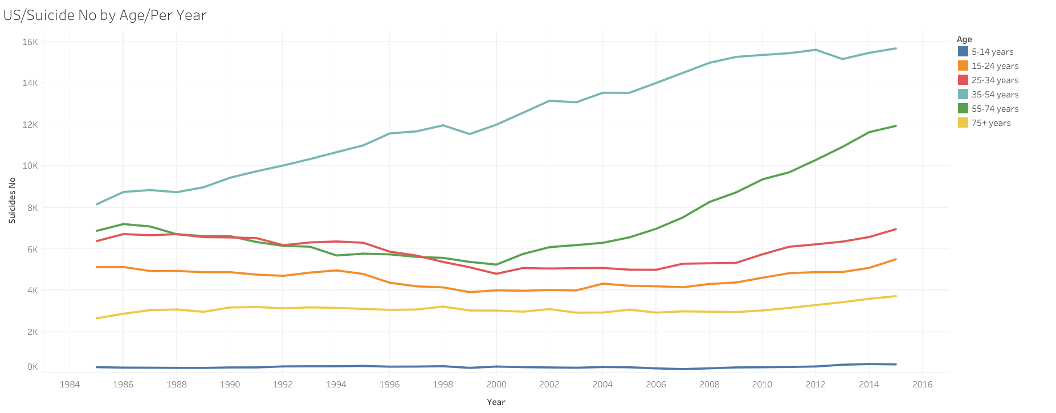
domestic statistics
This visualization shows the domestic suicide numbers over time by age.
Domestic Suicide numbers over time by Age

Slide 11
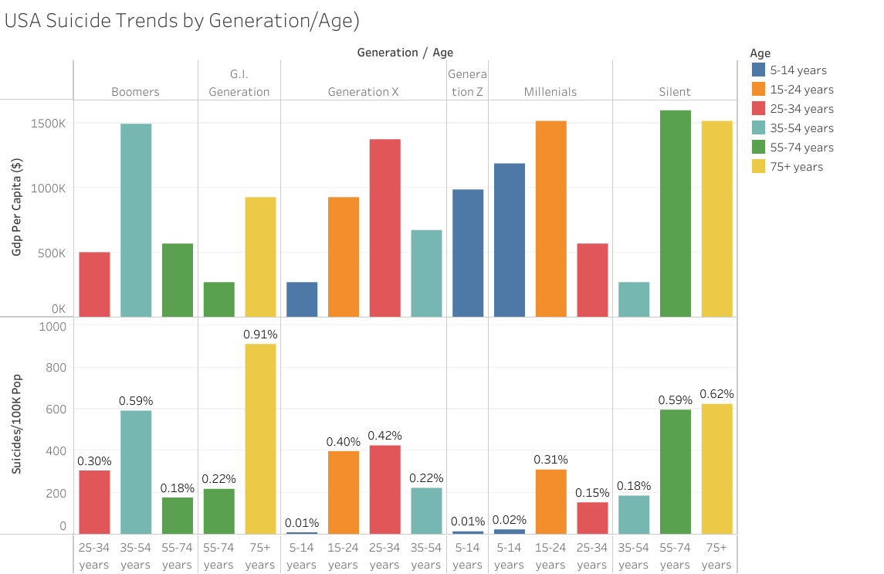
domestic statistics
This visualization shows the domestic suicide trends by generation and age factoring in GDP per Capita.
Domestic Suicide trends over time by Generation and Age.

Slide 12
Machine learning

Slide 13
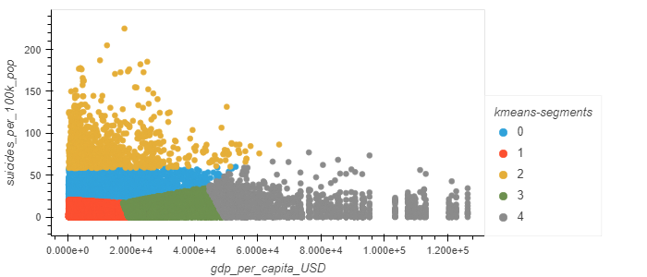
Unsupervised learning
KMeans with 5 clusters provided best model
Functional model, but not best approach overall

Slide 14

Neural net
First approach
Second approach
Created dummies for all variables except the suicide rate. Failed to exceed 1% accuracy
Fewer variables, using only dummies for sex and age. Better, but failed to exceed 10% accuracy
Third approach
Final approach
Created suicide rate buckets, all variables included again.
Accuracy still an issue
Hypertuned with Keras Tuner
Successfully exceed 85% accuracy

Slide 15
Thank you

